Slide 1
18 - Non-Photorealistic (Expressive) Rendering
Dr. Hamish Carr & Dr. Rafael Kuffner dos Anjos

Slide 2
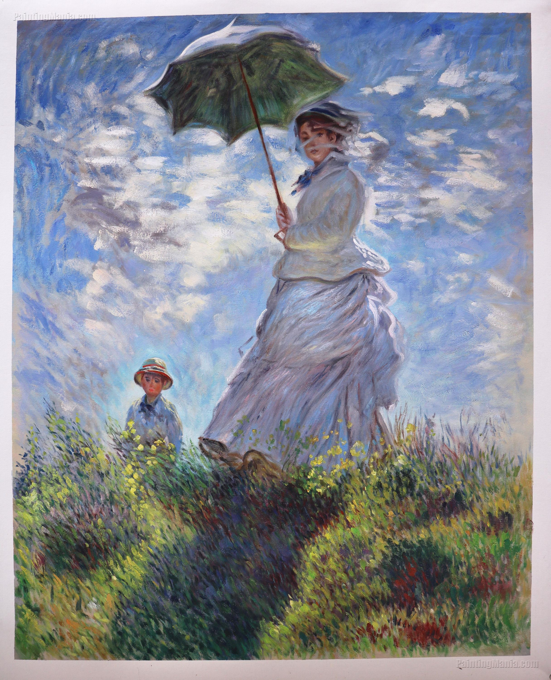
Artists & Rendering
Art isn't always realistic
Which doesn't mean it's bad
How do we reproduce it?
Start by understanding it

Slide 3
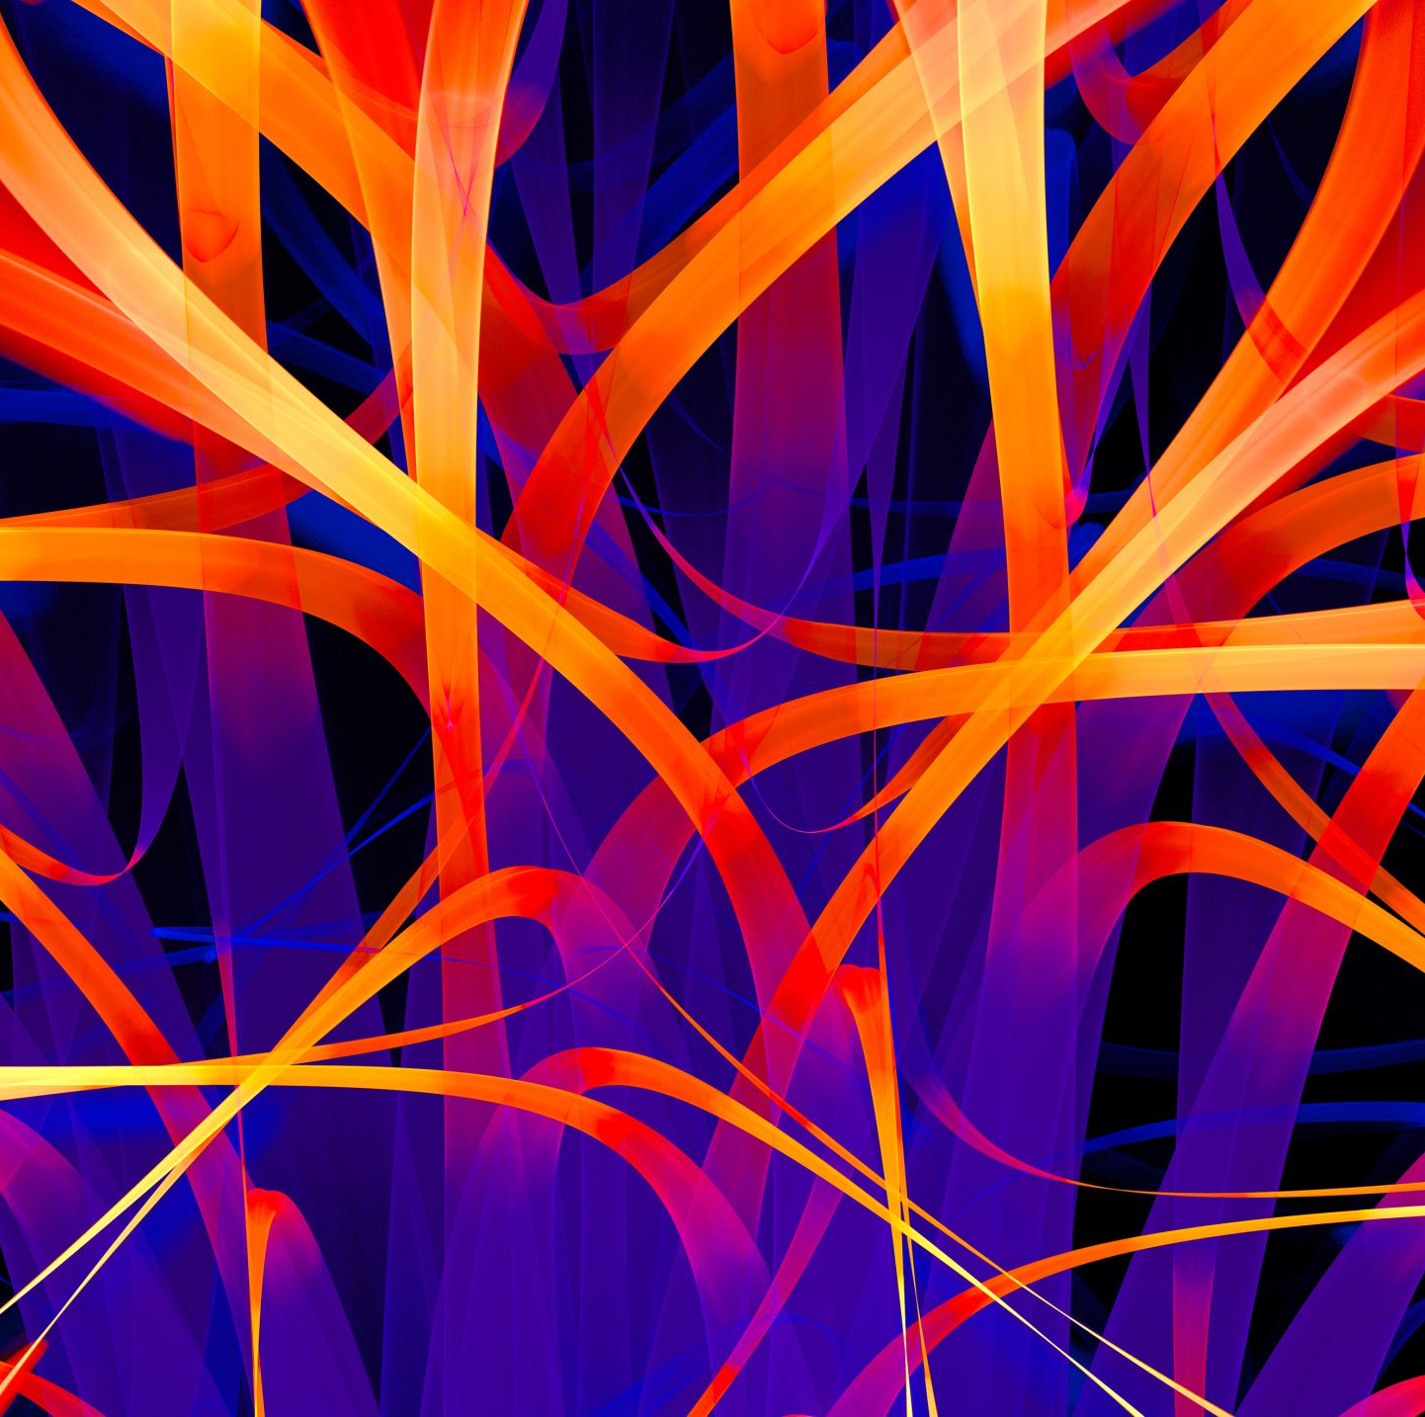
Artistic Style & Intent
Artists discuss their
style: details of technique & tools
intent: what they wish to achieve
message: what they wish to say
abstraction: what they wish to remove
Illustration is generally intent + abstraction
Fine art is generally message + style

Slide 4
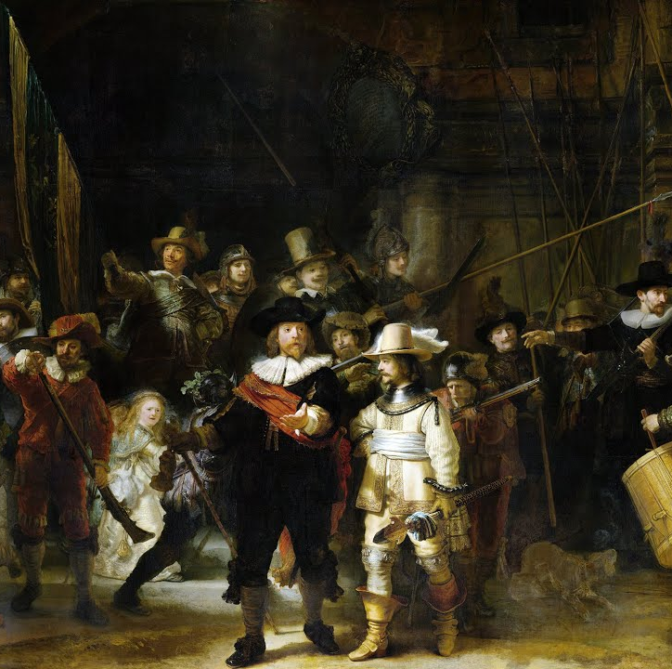
Perceptual Issues
Humans are very edge-sensitive
So a sketch draws only edges
The oldest art tools generate edges
Paint, carving, ink, pencils
Humans also use shading to infer shape
So strokes & shadows are behind most of this

Slide 5
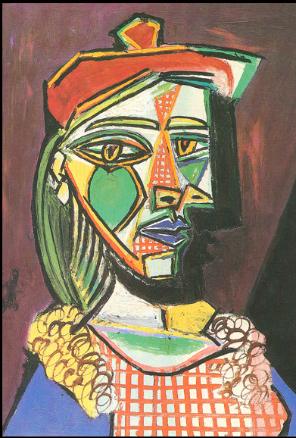
Abstraction
Represents the essence of the object
At the expense of detail
Simplify: remove redundant detail
Factorise: separate generic & specific
Schematise: substitute representations
Stripping the image down amplifies meaning

Slide 6
Examples
Detail omission
(suppression of
redundant detail)
Edge enhancement
(Edges in Z-buffer)
Stylised Contours
(Emphasis on edges)
Painterly strokes
(Stylistic imitation)

Slide 7
Curve Extraction
Silhouettes separate back-/fore-ground
Eye rays are tangent
Creases
Tangent discontinuities
Cusps
Eye ray tangent to curve

Slide 8

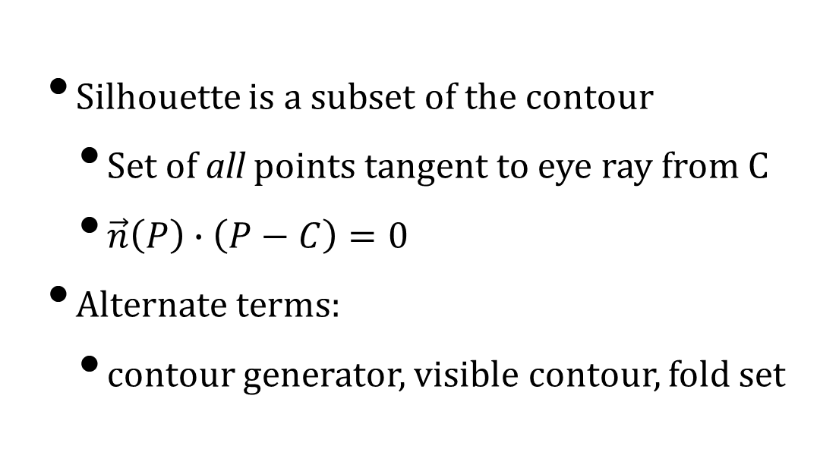
Contour
Silhouette is a subset of the contour
Set of all points tangent to eye ray from C
$\vec{n}\left(P\right)∙\left(P−C\right)=0$
Alternate terms:
contour generator, visible contour, fold set

Slide 9

Polygonal Mesh Tangents
Polygonal meshes are a nuisance
Silhouette is made up of mesh edges
But tangent planes do not exist at edges
Most meshes derive from smooth surfaces
But may have crease edges marked
Edges which are intended to be sharp

Slide 10
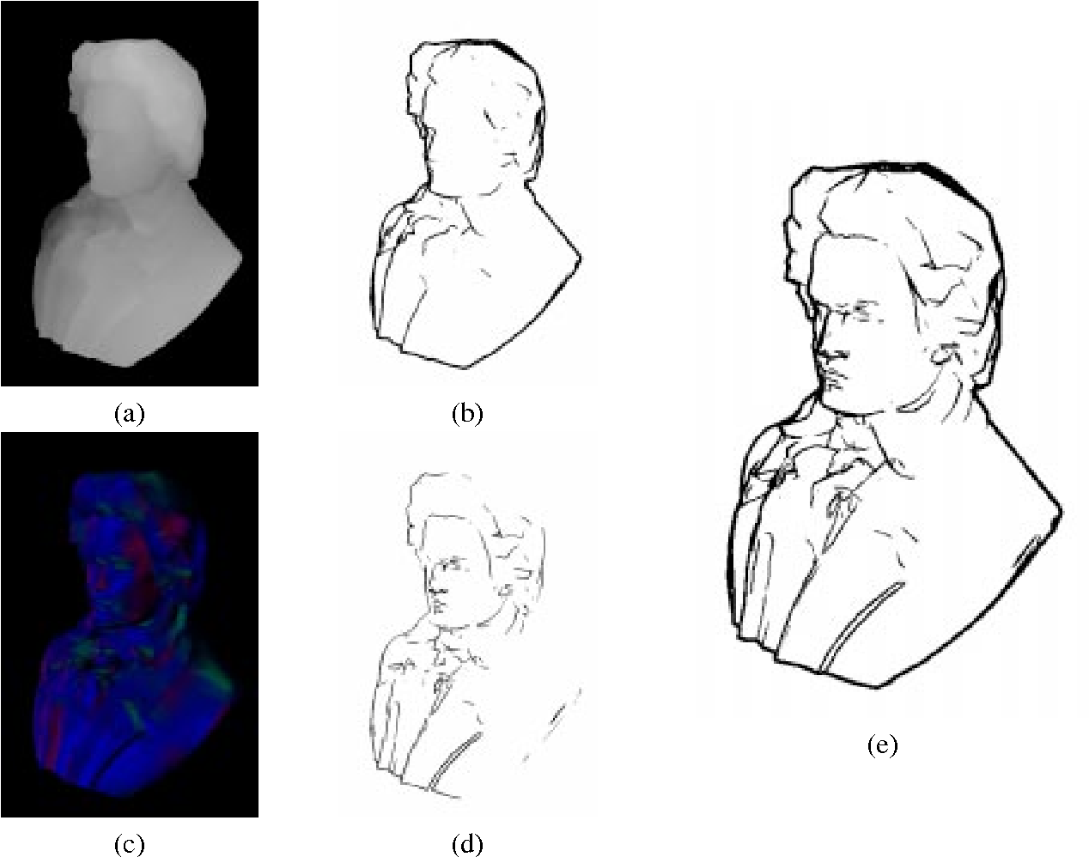
Simple Silhouettes
Any edge connects two triangles
One triangle points toward the eye
The other points away from the eye
Test this with triangle normals (not vertex!)
Render the surface in white
Then render these edges in black
Optionally, offset slightly towards viewer
Aaron Hertzman, 1999

Slide 11
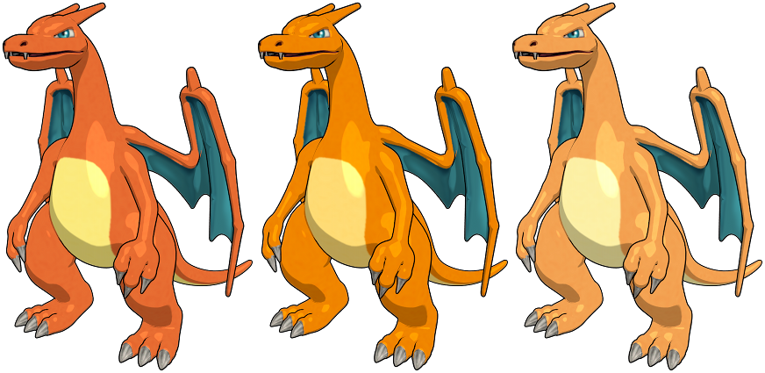
Cel (Toon) Shading
Detect & draw silhouette edges
Then simplify the shading
By thresholding the result
So only two or three colours are used
Looks like a hand-drawn cartoon
Relatively smooth perceptual changes
So not too many crawlies
LordOfDragons@Deviantart

Slide 12
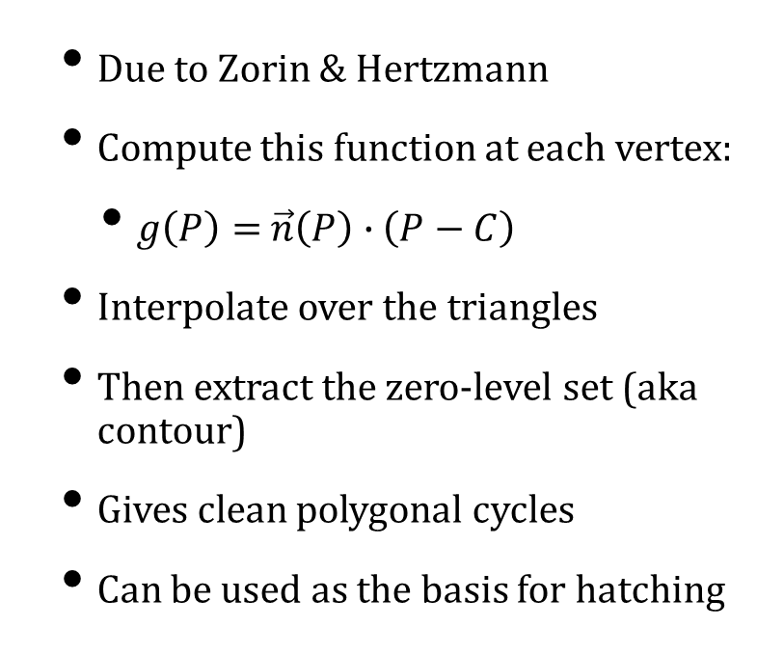
Contour Contours
Due to Zorin & Hertzmann
Compute this function at each vertex:
$g\left(P\right)=$ $\vec{n}\left(P\right)∙$ $\left(P−C\right)$
Interpolate over the triangles
Then extract the zero-level set (aka contour)
Gives clean polygonal cycles
Can be used as the basis for hatching

Slide 13
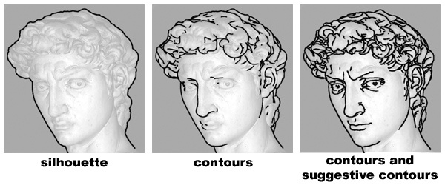
Suggestive Contours
We also want suggestive contours
That suggest details of the shape
E.g. edge of the eye (not a contour edge)
Based on extracting curvature (L1)
But polygonal meshes can be a problem
May need spline curves along the edges!
De Carlo et. Al 2003

Slide 14
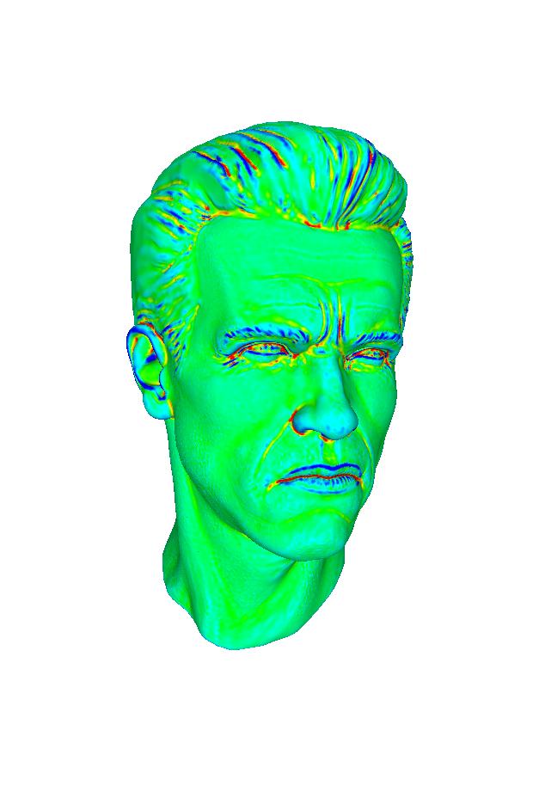
Principal & Secondary Curvature
Principal: direction of greatest change
Secondary: direction of least change
Guaranteed to be perpendicular
At least on smooth surfaces

Slide 15
Lines of Curvature
Line of curvature follows principal direction
Principal curvature changes along them
Therefore has minima and maxima
Called ridge and valley points

Slide 16
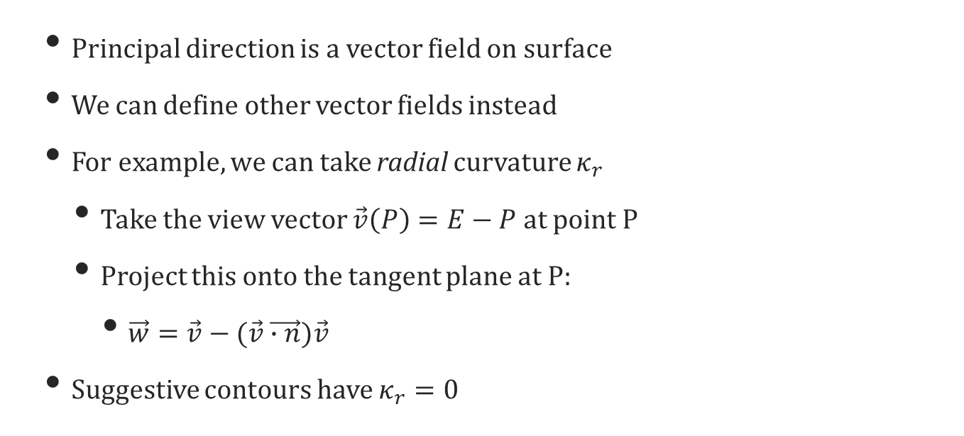
Suggestive Contours, II
Principal direction is a vector field on surface
We can define other vector fields instead
For example, we can take radial curvature $κ_{r}$
Take the view vector $\vec{v}\left(P\right)=E−P$ at point P
Project this onto the tangent plane at P:
$\vec{w}=\vec{v}−(\vec{v}\vec{∙n})\vec{v}$
Suggestive contours have $κ_{r}=0$

Slide 17
Suggestive Contours, &c.
1. Shaded View 2. Contours 3. Suggestive Contours 4. Ridges & Valleys 5. Apparent Ridges

Slide 18
Scene Abstraction
Selection of curves / lines to remove
i.e. when too many lines in a dense area

Slide 19
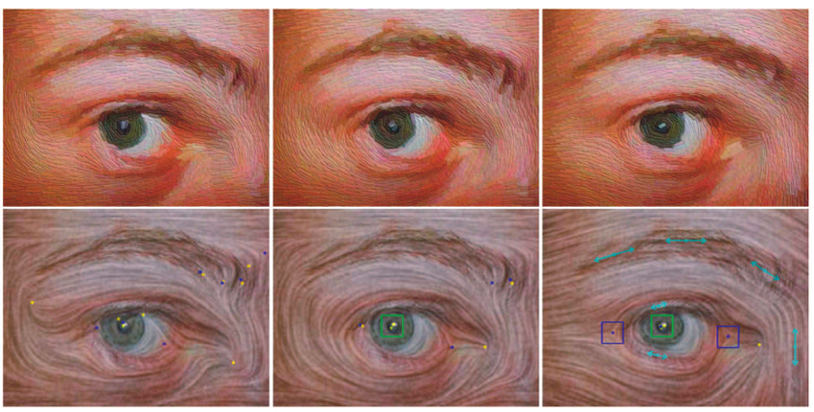
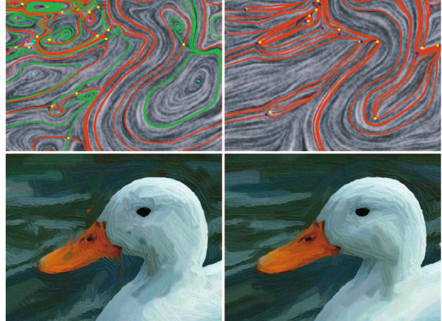
Image-space NPR
All of this can also be done in image space with filters
Render normally (or normals/tangents per pixel), then re-render.
Zhang et al. 2004

Slide 20
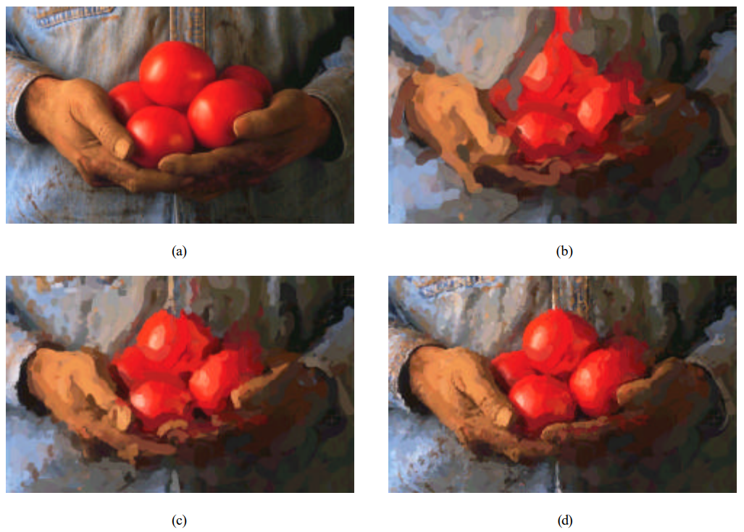
Painterly rendering
Break image down into features.
Replace elements with brush strokes
All image space: no mesh information used.

Slide 21
Diffusion Curves
Paint curves with colours on each side
Then diffuse the colour outwards until it meets

Slide 22
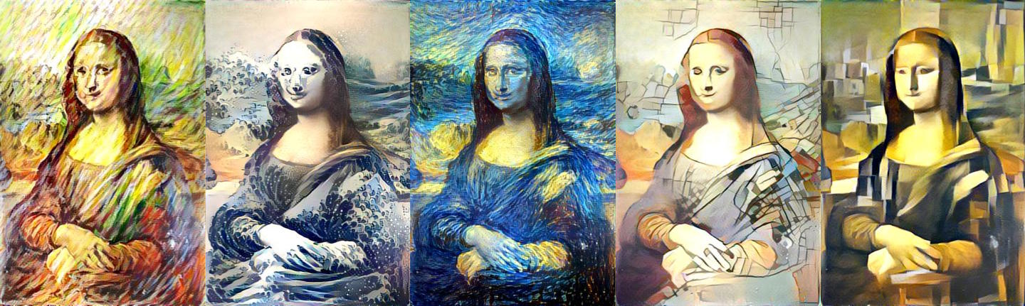
AI Style transfer
Basis for several popular “art filters”
Try to minimize perceptual loss from target image from style image.
Works sometimes.

Slide 23
Summary
Artists historically work with edges
Due to human eyeball, and tools available
Edges show up in curvature calculations
Shading is then simplified or blurred
Artistic style is copied with stroke styles
AI is becoming more popular in this area.

